Slide 1
Probability
July 08th, 2023

Slide 2
Today
Why do we need “Probability”
Computing Probabilities
Probability distributions
Joint, Marginal, and Conditional Probabilities
Sampling Methods

Slide 3
Question
How long does it take you to reach your college/office from home/hostel?
Because the time taken may vary from day-to-day, depending on many other factors, on any given day, we are uncertain about the exact time it would take.
Such variables are termed Random Variables
However, you are still able to answer that question with a single number, as in your mind you have an idea of an average time, or expected time to reach your college
You have implicitly used the basic concepts of Statistics, to answer that question

Slide 4
An example of a Machine Learning Problem
Identifying SPAM Mails
E-Mail | Suspicious Words | Unknown Sender | Spam
1 | Y | Y | Y
2 | N | Y | N
3 | Y | N | Y
4 | Y | N | N
5 | N | Y | Y
6 | Y | N | Y
7 | Y | N | Y
8 | Y | N | N
9 | N | Y | N
10 | Y | N | Y
E-Mail | Suspicious Words | Unknown Sender | Spam
1 | Y | Y | Y
2 | N | Y | N
3 | Y | N | Y
4 | Y | N | N
5 | N | Y | Y
6 | Y | N | Y
7 | Y | N | Y
8 | Y | N | N
9 | N | Y | N
10 | Y | N | Y
E-Mail | Suspicious Words | Unknown Sender | Spam
1 | Y | Y | Y
2 | N | Y | N
3 | Y | N | Y
4 | Y | N | N
5 | N | Y | Y
6 | Y | N | Y
7 | Y | N | Y
8 | Y | N | N
9 | N | Y | N
10 | Y | N | Y
Suspicious Words | Unknown Sender | Spam
Y | Y | ?
Suspicious Words | Unknown Sender | Spam
Y | N | ?
A new Mail Arrives
66.7% chance – Yes
33.3% chance - No

Slide 5
Why Probability and Statistics?
Remember the equation: v = u + at
If you know initial conditions: Value of u, and a, you can compute v for any given time t.
It doesn’t matter who does the computing, at what time of day, or in which country, the answer would be the same.
The variable, v is not affected by any random fluctuations
Such systems are called deterministic systems.
Systems which are affected by random fluctuations, are called Stochastic systems.
The time taken to reach college/office varies everyday is one such variable
Statistics and Probability is the science of dealing with uncertain data
The theory and methods of probability, enable us to treat “Uncertainty” in a mathematical framework

Slide 6
Probability

Slide 7
Back to School
An urn contains 12 red dice and 18 blue dice. If you are asked to draw 6 dice from the urn randomly, What is the probability that you will draw 3 red dice?
You land up at this old school meeting where there are 50 people including you. What is the probability that at least two of you share the same birthday?
If you toss a fair coin 50 times, what is the probability that you will get 30 heads?

Slide 8

Why do we talk about coin tosses ,cards and dice in Probability
Passes a quality test/Fails a quality test
Gender: Man/Women
Customer: Buys/Doesn’t buy
Education Level of an employee (many levels)
Colour of mobile phones (Many colours)
Brand of car (Many options)
Number of durables owned
Number of children at home
Number of promotions a employee is given

Slide 9
Randomness
In many situations one will know what are all the possible outcomes, but one cannot be certain about the exact outcome
e.g. You Buy a Lottery ticket
You may win, or may not win – Possibilities are fixed, known
Will you win, or not win – Exact outcome is uncertain
e.g. You roll a dice
You my get 1,2,3,4,5, or 6 - Possibilities are fixed, known
Will you get 1,2,3,4,5, or 6 - Exact outcome is uncertain
Both the examples above has an element of randomness that governs the outcome at any instance

Slide 10
Quantifying Randomness
Lets take the example of rolling the dice again
If two teams experiment (with 10 trials) to understand what is the proportion of the outcome being “6”, we may get something like this..
Roll (Trial) | Team I |  | Cumulative Proportion of 6's | Team II |  | Cumulative Proportion of 6's
1 | 6 |  | 1/1 | 1 |  | 0/1
2 | 5 |  | 1/2 | 2 |  | 0/2
3 | 1 |  | 1/3 | 1 |  | 0/3
4 | 6 |  | 2/4 | 1 |  | 0/4
5 | 6 |  | 3/5 | 3 |  | 0/5
6 | 2 |  | 3/6 | 2 |  | 0/6
7 | 3 |  | 3/7 | 4 |  | 0/7
8 | 1 |  | 3/8 | 5 |  | 0/8
9 | 4 |  | 3/9 | 3 |  | 0/9
10 | 4 |  | 3/10 | 6 |  | 1/10
You may have vastly different predictions with small number of trials – Expected of a random phenomenon
At the end of 250 trials, proportion of 6’s – 50/250, and at the end of 1000 trials – 170/1000

Slide 11
Quantifying Randomness - Probability
If the number of trials are large (or as they say “In the Long Run”),the proportion of 6’s will be closer to 1/6.
We are able to put a number of to the outcome.
Probability – The probability of a particular outcome is the proportion of times that particular outcome would occur in a long run of observations

Slide 12
Experiments and Outcomes
Let us say, we toss a coin three times:
Why? – We may like to ascertain whether the coin is fair
A quality control unit decides to sample “n” products out of “N” produced and classifies each of the n products as “Quality Passed”, or Quality Failed”
The above are examples of “Experiments”, or Sample Studies”
What are the different possible results when we toss a coin three times?
Toss 1 | Heads |  |  |  | Tails
Toss 2 | Heads |  | Tails |  | Heads |  | Tails
Toss 3 | Heads | Tails | Heads | Tails | Heads | Tails | Heads | Tails
Summary Result | HHH | HHT | HTH | HTT | THH | THT | TTH | TTT
Outcomes
Each possible result of the experiment is called an “Outcome”

Slide 13
Sample Space and Events
Sample Space is the set of all possible outcomes in a random phenomenon
e.g. Let us say, we roll a die: X = The top face of the die, a random variable
The sample space is: {1, 2,3,4,5,6} – six Possible outcomes
An Event is a subset of the sample space and some examples are:
Event A: Getting an Even number: {2, 4,6} – three possible outcomes
Event B: Getting a perfect square: {1, 4} – two possible outcomes
Q: If Event C is defined as “ Getting a prime number”, How many outcomes will be there in the event space, and what are those outcomes?
Event C: Getting a prime number: {2, 3, 5} – three possible outcomes

Slide 14
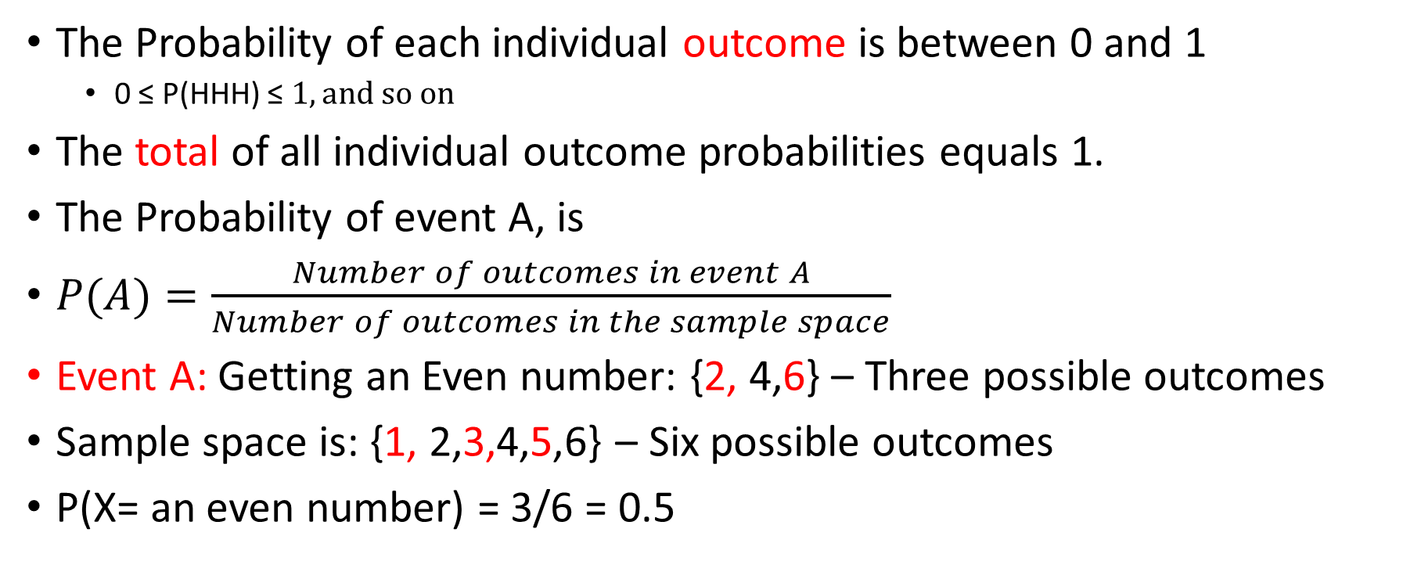
Probabilities for an Event
The Probability of each individual outcome is between 0 and 1
0 ≤ P(HHH) ≤ $1, and so on$
The total of all individual outcome probabilities equals 1.
The Probability of event A, is
$P(A)=\frac{Number of outcomes in event A}{Number of outcomes in the sample space}$
Event A: Getting an Even number: {2, 4,6} – Three possible outcomes
Sample space is: {1, 2,3,4,5,6} – Six possible outcomes
P(X= an even number) = 3/6 = 0.5
Probability (X= a prime number) = 3/6 = 0.5

Slide 15
Independent Events
Definition: Two events are independent if occurrence of one has no influence on occurrence of other
Example: Lets throw a die twice. What is the probability of getting 1 in first throw, and 5 in second throw?
Sample Space: { (1,1), (1,2)….(1,6), (2,1), (2,2), …(2,6)…..(6,1), (6,2)….(6,6) } – 36 Possibilities
Event Space: {(1,5)} – One possibility
Probability (1,5) = 1/36
But we know that the two throws of the die are independent. i.e. What happens in the first throw does not affect what happens in the second throw.
i.e. If we consider each throw as an event (A and B) these two events are independent.
The product rule states that if two events A, and B are independent, then, Probability of A and B occurring is given by
$$P\left(A∩B\right)=P\left(A\right)×P(B)$$
Therefore, P(1,5) = P(1 in throw 1) x P(5 in throw 2) = (1/6) x (1/6) = 1/36
Example of dependent events:
Two card players are dealt two cards each by turn. You receive the first card, and it is a spade. (Probability: 13/52). The other player gets his first card. Then you get your second card: What is the probability that the second card you received is also a spade ??? – This probability depends on what suit did the other player get
Notes:
Notes for Nandan:
Sales/Marketing: Choose a set of people to get satisfaction survey or choose a set of people to promote something to find out if it is an attractive feature
Credit: We need details on the credit demographic of different types of car purchasers. Take a sample and ask a credit rating agency
Operations: We have a rich data set of people of how long people spend in our showrooms and whether they purchased a product or not. Take a random sample to help capacity planning.

Slide 16
Mutually Exclusive Events
Definition: Two events are mutually exclusive if occurrence of one prevents the occurrence of the other
i.e. Mutually Exclusive events are events which do not have any common outcomes
e.g. Let us say, we roll a die: X = The top face of the die, a random variable
The sample space is: {1, 2,3,4,5,6} – six Possible outcomes
Event J: Getting an even number: {2, 4,6} – three possible outcomes
Event K: Getting a perfect square: {1, 4} – two possible outcomes
Event M: Getting a prime number: {2, 3, 5} – three possible outcomes
The addition rule states that if two events A, and B are mutually exclusive, then, Probability of A or B occurring is given by
$$P\left(A∪B\right)=P\left(A\right)+P(B)$$
Events K, and M are mutually exclusive, as there are no common outcomes between the two events
∴ P((X=perfect square) or (X=prime number)) = P(X=perfect square) + P(X=prime number) = (2/6) + (3/6) = 5/6
Q: What would be the P((X = Even Number) or (X=perfect square))?
Events K, and J are NOT mutually exclusive, as 4 is a common outcome in the two event sets
If two events A, and B are NOT mutually exclusive, then, Probability of A or B occurring is given by
$P\left(A∪B\right)=P\left(A\right)+P(B)$ - $P\left(A∩B\right)$
∴ P((X = Even Number) or (X=perfect square)) = (3/6) + (2/6) – (1/6) = 4/6
Notes:
Notes for Nandan:
Sales/Marketing: Choose a set of people to get satisfaction survey or choose a set of people to promote something to find out if it is an attractive feature
Credit: We need details on the credit demographic of different types of car purchasers. Take a sample and ask a credit rating agency
Operations: We have a rich data set of people of how long people spend in our showrooms and whether they purchased a product or not. Take a random sample to help capacity planning.

Slide 17
Useful Counting Techniques
Most of the computations of probability involves “Counting”
In a restaurant, there is an option of “a” number of (say 6) dishes, and b number of (say 5) beverages, and you could pick one of each. How many different choices are available to you?
Ans: 6x5 = 30
If you are given “n” (say 4) different alphabets, and are asked to form “r” (say 3) letter PIN codes, (You can reuse an alphabet), how many codes can be generated?
Ans: 4x4x4 = 64 = n^{r}

Slide 18
Useful Counting Techniques
If you are given “n” (say 4) different alphabets, and are asked to form “r” (say 4) letter PIN codes, (You can use each alphabet only once), how many codes can be generated?
Ans: 4x3x2x1 = 24 = n x (n-1) x (n-2) x …..x 2 x1 = n!
Total number of ordered sequences for “n” distinguishable objects is n!
If you are given four different alphabets, and are asked to form two letter PIN codes, (You can use each alphabet only once), how many codes can be generated?
Ans: 4x3 = 12 = $\frac{4∗3∗2∗1}{2∗1}$ = $\frac{n!}{\left(n−r\right)!}$
In both the problems above the order in which the alphabets appear is important. (i.e. “ab”, and “ba” are two different PIN codes)

Slide 19
Useful Counting Techniques
Consider this problem: there are “n” (say 4) teams in a tournament (A,B,C,D), and each team plays the other once (i.e. “r” =2). How many matches are there in total?
(A,B), (A,C), (A,D), (B,C),(B,D), (C,D) – Six in total
Y$ou can show this to be equal to \frac{n!}{r!\left(n−r\right)!}$
The term above is referred to as Binomial coefficient and is notated as $\left({n \atop r}\right)$

Slide 20
Computing probabilities using Rules and techniques
An urn contains 12 red dice and 18 blue dice. If you are asked to draw 6 dice from the urn randomly, What is the probability that you will draw 3 red dice?
Problems of this type are called the “urn” model problems.
Total number of ways you can draw 6 dice from a total of 30 dice is $\left({30 \atop 6}\right)$ - Sample Space
Total number of ways you can draw 3 red dice from a total of 12 red dice is $\left({12 \atop 3}\right)$
Total number of ways you can draw 3 Blue dice from a total of 18 Blue dice is $\left({18 \atop 3}\right)$
Total number of ways you can draw 3 Red and 3 Blue dice from a total of 12 Red and 18 Blue dice is $\left({12 \atop 3}\right) \left({18 \atop 3}\right)$ - Event Space
Probability of (3 R, From 12 R and 18 B, given n= 6) = $\frac{\left({12 \atop 3}\right)\left({18 \atop 3}\right)}{\left({30 \atop 6}\right)}$ = 0.302

Slide 21
Same Birthday Problem – Using Rules and Techniques
You land up at this old school meeting where there are 50 people including you. What is the probability that at least two of you share the same birthday?
Standard Approach – by counting
Probability of at least two of the students having the same birthday = 1 – (Probability of no one having the same birthday)
Probability of no one having the same birthday = $\frac{count of all possibilities where no one has the same birthday (Event Space)}{Count of all possibilities (Sampe Space)}$
Count of all possibilities (sample Space)
Student | 1 | 2 | 3 | ……… | ………… | ………… | 49 | 50
Possible days of birth | 365 | 365 | 365 | 365 | 365 | 365 | 365 | 365
Probability that at least two share a birthday = 0.97
Total number of possibilities = 365⁵⁰
$$count of all possibilities where no one has the same birthday (Event Space)$$
Student | 1 | 2 | 3 | ……… | ………… | ………… | 49 | 50
Possible days of birth | 365 | 364 | 363 |  |  |  | 317 | 316
Total number of possibilities = 365*364*363*……..*317*316

Slide 22
Probability Distributions

Slide 23
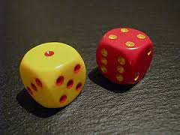
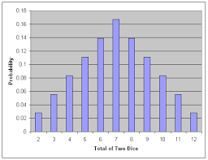
Probability Distribution Functions – By Example
Throwing two dice together
Each die can turn up with any one of 6 values {1,2,3,4,5,6}. For two dice, there are a total of 6x6 = 36 combinations {Sample Space}
The sum of the two die values cannot be 0, or 1, and also cannot be greater than 12
We can get a sum of 2, through only one combination: {1,1}. Hence probability of sum = 2, is 1/36
We can get a sum of 6, through the following combinations: {1,5}, {5,1}, {2,4}, {4,2}, {3,3}.Hence probability of sum = 6, is 5/36
Sum | 2 | 3 | 4 | 5 | 6 | 7 | 8 | 9 | 10 | 11 | 12 | Total
Probability | 1/36 | 2/36 | 3/36 | 4/36 | 5/36 | 6/36 | 5/36 | 4/36 | 3/36 | 2/36 | 1/36 | 1
A plot of the probabilities, is called the probability distribution function
For discrete random variables such plot , is called the probability mass function (pmf)
For continuous random variables such plot , is called the probability density function (pdf)
You can describe such functions as appropriate mathematical equations

Slide 24
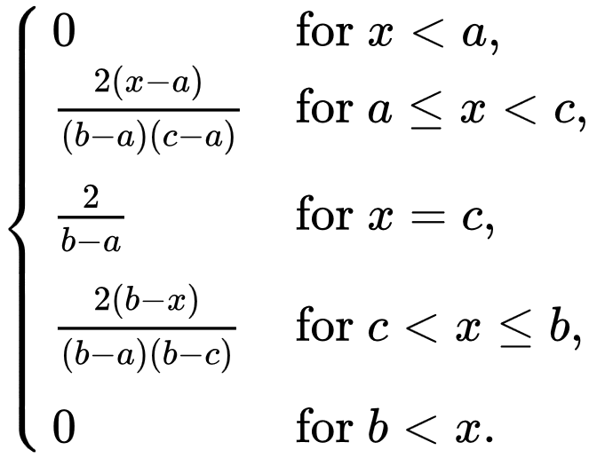



Computing Probabilities from distributions
For Probability Mass Functions – for discrete variables
$$p(x=c)=\frac{2}{(b−a)}$$
-----------------------------
Probability
500 simulated rolls
a = 1
c = 7
b = 13
$p(x=7)=\frac{2}{(13−1)}$ = $\frac{1}{6}$ = $\frac{6}{36}$
Outcomes
$p(x=5)=\frac{2(x−a)}{(b−a)(c−a)}$ = $\frac{2(5−1)}{(13−1)(7−1)}$ = $\frac{8}{(12)(6)}$ = $\frac{4}{36}$
Sum | 5 | 7 | 10
Probability | 4/36 | 6/36 | 3/36
$p(x=10)=\frac{2(b−x)}{(b−a)(b−c)}$ = $\frac{2(13−10)}{(13−1)(13−7)}$ = $\frac{6}{(12)(6)}$ = $\frac{3}{36}$

Slide 25
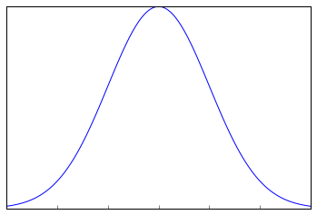
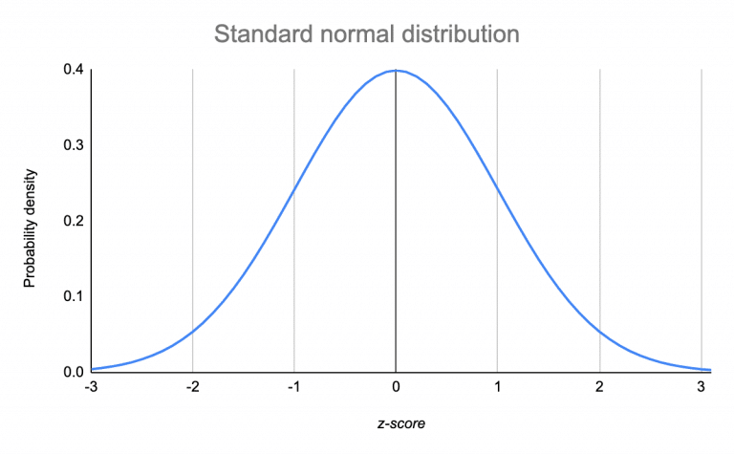
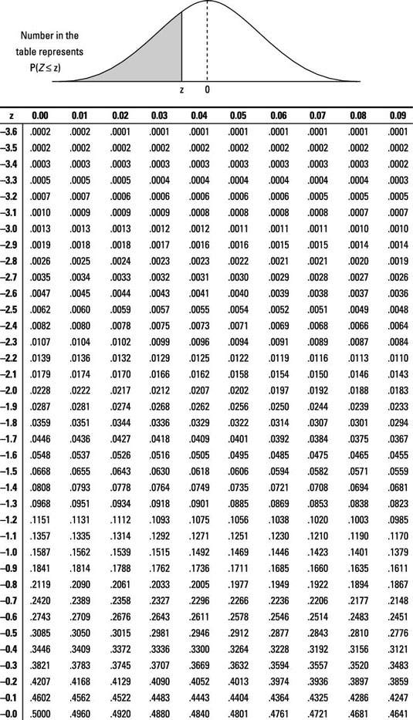
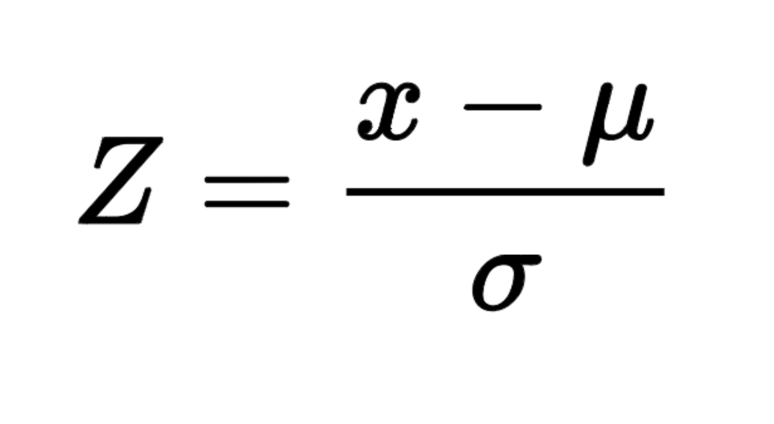



Computing Probabilities from distributions
Supposing we measure the weight of each individual in this group with a very sensitive scale (accurate up to 6 decimal points). The average weight of the group is 72.654734 Kg, and the standard deviation is 12.65 kg. If I randomly pick up one individual in the group, what is the probability that, that person weighs exactly 69.765438 kg ?
What is the probability that the weight of that person is between 65 – 70 Kg?
For Probability Density Functions – for continuous variables
Probability Density
$z\text{a}\text{=}$ = $\frac{a−µ}{σ}$
$z\text{b}\text{=}$ = $\frac{b−µ}{σ}$
a
b
b
Outcomes
The area under this graph is given by this table
a
The area under the curve defines the probability, and
The total area = 1

Slide 26
Expected Value
Expected value of a random variable X (Denoted by E[X]) is the weighted average of all possible values the event can take, weighted by the probability of occurrence of each event.
Example:
Let us assume a roulette wheel has 38 slots, and you are betting on one of the numbers where the roulette ball will settle down finally. If you bet one unit of currency, and choose a number and If the ball actually lands in the number you have chosen you win 30 units of currency, otherwise you loose your one unit of currency.
Assuming the roulette board is fair, what is the expected value of your bet? i.e. E[Gain from 1 unit of bet]
Since there are 38 slots, each slot has a chance of 1/38, to receive the ball finally
So, your win probability is 1/38, and lose probability is 37/38
E[Gain from 1 unit of bet] = (30*1/38) + (-1 * 37/38) = (30/38) – (37/38) = -7/38

Slide 27
Expected Value –Another example
Hrs | Frequency
X | f
68 | 1
62 | 1
59 | 1
57 | 1
56 | 1
55 | 1
54 | 2
53 | 2
52 | 2
51 | 2
50 | 3
49 | 2
48 | 2
47 | 1
46 | 2
45 | 1
44 | 1
42 | 1
39 | 1
33 | 1
27 | 1
Probability
p
0.033
0.033
0.033
0.033
0.033
0.033
0.067
0.067
0.067
0.067
0.100
0.067
0.067
0.033
0.067
0.033
0.033
0.033
0.033
0.033
0.033
1
P Weighted
Hrs
2.27
2.07
1.97
1.90
1.87
1.83
3.60
3.53
3.47
3.40
5.00
3.27
3.20
1.57
3.07
1.50
1.47
1.40
1.30
1.10
0.90
49.67
What is the expected value of battery life?
E[X] =49.67 Hours

Slide 28
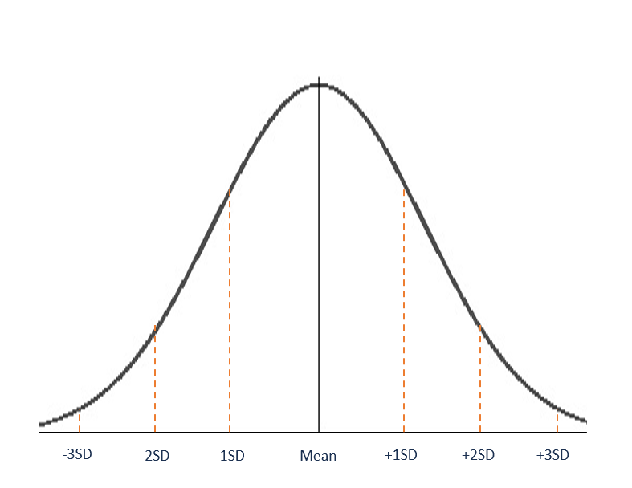
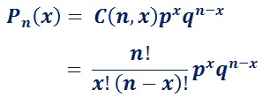
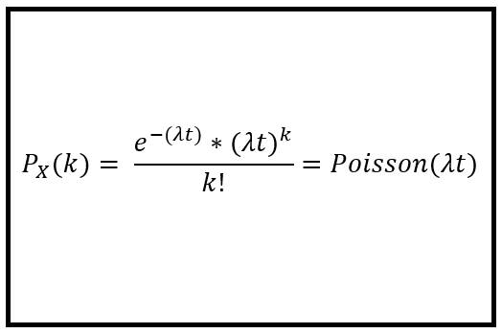
Commonly encountered distribution functions
Normal Distribution
Parameters: μ,σ
Describe Events that has
Continuous outcomes
Binomial Distribution
Describe Discrete Events that has
Two Outcomes
Trials are independent
Parameters: n,p
Poisson Distribution
Parameters: λ
Describe Discrete Events that occur at some rate over time

Slide 29
Binomial Distribution
If you toss a fair coin 50 times, what is the probability that you will get 30 heads?
The Binomial model is appropriate, when you have a sequence of independent trials, and each trial has only two outcomes
Binomial Distribution
For the following values:
n = 50
p = 0.5
q= 0.5
x = 30
You can compute the Probability (30 Heads, in a 50 tosses) = 0.042 (or 4.2%)
Product Rule for independent events
Counting Technique
As to where in the sequence the heads and tails appear

Slide 30
Use of Binomial Distribution - Example
Your quality control department estimates that 98% of products pass through the test normally.
On a given day, they had produced 1000 products and tested 100 of them.
What are the probabilities of getting 0,1,2,..defects out of 100
The Binomial model is appropriate, when you have a sequence of independent trials, and each trial has only two outcomes
Assuming the current lot has 2% defects, we can compute the probabilities using
# of Defects | % probability
0 | 13
1 | 27
2 | 27
3 | 18
4 | 9
5 | 4
6 | 1
7 | 0
8 | 0
9 | 0
10 | 0
For the following values:
n = 100
p_{Defects} = 0.02
q= 0.98
x = 1,2,3,….
Supposing you actually detected 6 defects. It could mean one of two things.
You are witnessing a very rare event.. Unlikely, we are not that lucky
Your assumption that this lot has only 2% defect is wrong. There are more than 2% defects in the 1000 products

Slide 31
In real life data science..
In the previous example, we computed the probability of getting six defects out of 100 (i.e. Defects proportion, p = 0.06), if the population defects proportion is 2% (i.e. π = 0.02)
In most data science problem, we are faced with the reverse problem. That is, given that we have got, six defects out of 100 (i.e. Defects proportion, p = 0.06), what is the best estimate for the population defects (i.e. π = ?)
One cumbersome way is to assume different values of π (or p) and check for which value of π (or p) , do we get the maximum probability of getting 6 defects out of 100, using the binomial distribution equation.
π Value | Likelihood of p=0.06, for n=100
0.01 | 0.000
0.02 | 0.011
0.03 | 0.050
0.04 | 0.105
0.05 | 0.150
0.06 | 0.166
0.07 | 0.153
0.08 | 0.123
0.09 | 0.089
0.1 | 0.060
0.11 | 0.037
0.12 | 0.022
0.13 | 0.012
0.14 | 0.006
0.15 | 0.003
0.16 | 0.002
0.17 | 0.001
0.18 | 0.000
0.19 | 0.000
We observe that the maximum likelihood is at p=0.06.
Inferential statistics (Range Estimates, Hypothesis Testing) are used to get a fine-tuned estimation of π
But, the likelihood for p=0.05, or p =0.07 are also comparable to p=0.06

Slide 32
Use of Poisson Distribution - Example
YEAR | 1 | 2 | 3 | 4 | Average # Purchases/Year
Customer 1: No of Purchases | 3 | 4 | 2 | 3 | 3
3 is the average # of purchases that the customer makes in a year. The actual number of purchases in a given year can be anywhere from 0 to ∞
If the purchase process follows a Poisson distribution, the probability of X = k purchases is given by the formula
Where,
λ = Average Rate = 3
k = No of Likely Purchases 1,2,3…
t = Time period
Average # of Purchases λ | 3
# of Purchases k | Probability (X =k)
0 | 0.05
1 | 0.15
2 | 0.22
3 | 0.22
4 | 0.17
5 | 0.10
6 | 0.05
7 | 0.02
8 | 0.01
9 | 0.00
Though we do not know exactly the number of purchasers a specific customer would make, we know the probability of his making 1 purchase, 2 purchases etc….

Slide 33
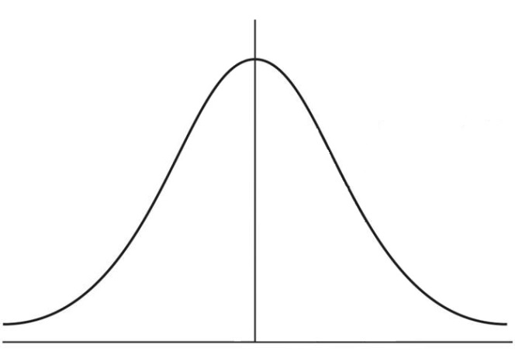
Use of Normal Distribution - Example
A company monitored their monthly transportation cost over a long period of time and found it to be approximately normally distributed with a mean value of ₹ 4,00,000/- with a standard deviation of ₹ 20,000.
If they have budgeted ₹ 4,40,000/- for the next month, what is the probability that the actual costs will exceed the budgeted amount?
μ = ₹ 4,00,000
σ = ₹ 20,000
Area
x = ₹ 4,40,000
You can compute the probability as 0.0228 (2.28%)

Slide 34
Probability Joint, Marginal, and Conditional

Slide 35
Marginal & Joint Probabilities
Days of | Rains | No Rains | Total
Thick Clouds | 24 | 6 | 30
Light Clouds | 21 | 49 | 70
Total | 45 | 55 | 100
Out of 100 days – 30 days had Thick Clouds : P(Thick Clouds) = 0.30
Out of 100 days – 70 days had Light Clouds: P(Light Clouds) = 0.70
Out of 100 days – 45 days had rains: P(Rains) = 0.45
Out of 100 days – 55 days had Rains: P(No Rains) = 0.55
All of these are
Marginal Probabilities
Days of | Rains | No Rains | Total
Thick Clouds | 0.24 | 0.06 | 0.3
Light Clouds | 0.21 | 0.49 | 0.7
Total | 0.45 | 0.55 | 1
Out of 100 days – 24 days had Thick clouds and Rains
i.e. P(Thick Clouds ∩ Rains) = 0.24
P(Light Clouds ∩ Rains) = 0.21
P(Thick Clouds ∩ No Rains) = 0.06
P(Light Clouds ∩ No Rains) = 0.49
All of these are
Joint Probabilities

Slide 36
Conditional Probabilities
Days of | Rains | No Rains | Total
Thick Clouds | 24 | 6 | 30
 | 0.8 | 0.2 | 1
Light Clouds | 21 | 49 | 70
 | 0.3 | 0.7 | 1
Total | 45 | 55 | 100
On the 30 days we had Thick Clouds – It Rained on 24 days
P(Rains, If we had thick clouds) = 0.8
P(Rains|Thick Clouds) = 0.8
P(No Rains|Thick Clouds) = 0.2
All of these are
Conditional Probabilities
P(Rains|Light Clouds) = 0.3
P(No Rains|Light Clouds) = 0.7
Days of | Rains | No Rains | Total
Thick Clouds | 24 | 6 | 30
 | 0.53 | 0.11
Light Clouds | 21 | 49 | 70
 | 0.47 | 0.89
Total | 45 | 55 | 100
 | 1 | 1
P(Thick Clouds|Rains) = 0.53
P(Rains|Thick Clouds) = 0.8
P(Thick Clouds|Rains) = 0.53
Notice that we had 24 days in which we had both Thick clouds and Rains
The same number is expressed as a proportion two different bases.
Is it possible that these probabilities can be linked through some mathematical expression?

Slide 37
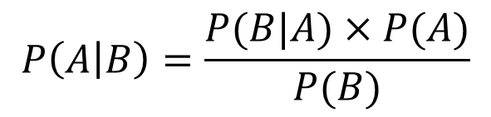

Bayes Theorem
Days of | Rains | No Rains | Total
Thick Clouds | 0.24 | 0.06 | 0.3
Light Clouds | 0.21 | 0.49 | 0.7
Total | 0.45 | 0.55 | 1
Days of | Rains | No Rains | Total
Thick Clouds | 0.24 | 0.06 | 0.3
Light Clouds | 0.21 | 0.49 | 0.7
Total | 0.45 | 0.55 | 1
0.8
0.2
1.0
0.53
0.47
1.0
P(Thick Clouds) = 0.30
P(Thick Clouds ∩ Rains) = 0.24
P(Rains) = 0.45
P(Rains ∩ Thick Clouds) = 0.24
P(Rains|Thick Clouds) = $\frac{\text{P}\text{(}\text{Thick} \text{Clouds} \text{∩} \text{Rains}\text{)}}{\text{P}\text{(}\text{Thick} \text{Clouds}\text{)}}$ = 0.8
P(Thick Clouds|Rains) = $\frac{\text{P}\text{(}\text{Rains}\text{∩} \text{Thick} \text{Clouds}\text{)}}{\text{P}\text{(}\text{Rains}\text{)}}$ = 0.53
We can re-write the above equation as:
P(Thick Clouds ∩ Rains) = P(Rains|Thick Clouds) * P(Thick Clouds)
We can re-write the above equation as:
P(Rains∩ Thick Clouds) = P(Thick Clouds|Rains) * P(Rains)
∴ P(Rains|Thick Clouds) * P(Thick Clouds) = P(Thick Clouds|Rains) * P(Rains)
$P\left(B\right)$X $P\left(A | B\right)= P\left(A\right) \text{X} P(B|A)$
$$P\left(A | B\right)=\frac{P(B|A)×P(A)}{P(B)}$$
Bayes theorem

Slide 38
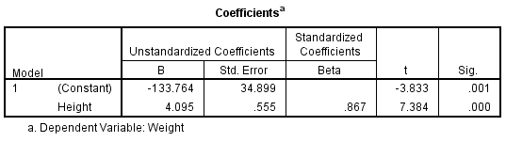
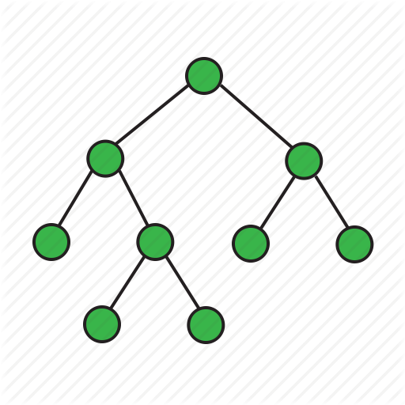
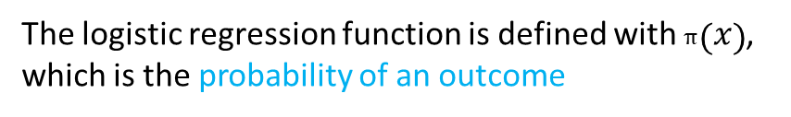
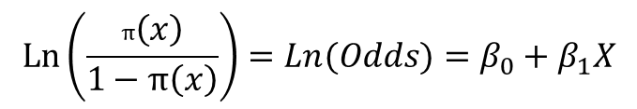
Use of Theory of probability in data science – More Examples
Regression
Inferential statistics, for which the backbone is the probability theory
Logistic Regression
$$\operatorname{Ln}\left(\frac{π\left(x\right)}{1−π\left(x\right)}\right)=Ln(Odds)=β_{0}+β_{1}X$$
The logistic regression function is defined with $π\left(x\right)$, which is the probability of an outcome
Decision Trees and Random Forest
Efficient construction of trees and forest is achieved by using measures such as: Entropy, Information Gain, and Gini Index all of which are probability measures.

Slide 39
Use of Theory of probability in data science – More Examples
Customer Life Time Value (LTV) – The BG/NBD - Model
The model Considers the following:
The number of purchases in a given time
The model assumes that while alive, each customer purchases according to a Poisson probability process with parameter λ (purchase rate)
The parameter λ is different across customers, and the model assumes that heterogeneity in that process is captured by a gamma probability distribution, with parameters r, and α
Will a customer remain alive? (i.e. will he stay with us as a customer?)
Each Customer’s lifetime is assumed to follow a geometric probability distribution, with a parameter p (Probability of a customer becoming inactive after a transaction)
The average monetary value z of each customer is estimated using the Gamma – Gamma probability Model

Slide 40
Population and Sample

Slide 41
Population and Sample
Population:
Refers to the whole group or set of data points on which inferences or predictions are to be made
Size of the population could be very large depending on the inference to be made
Battery life example: Population is the set of all mobiles of that particular model
OTT example: Population is the set of all people in India who watch movies on OTT platforms
Sample:
A set of data points which are representative of the population
Size of sample set is generally much smaller than the size of population

Slide 42
Obtaining Sample from Population
Population dataset
Sampling is performed to get a sample set from the actual population
3 types of Sampling:
Random sampling: Each data point of population is picked with equal probability
1
2
3
4
5
6
7
8
9
10
11
12
13
14
15
16
17
18
19
20
21
22
23
24
1
5
Randomly
Sampled
dataset
6
10
16
21

Slide 43
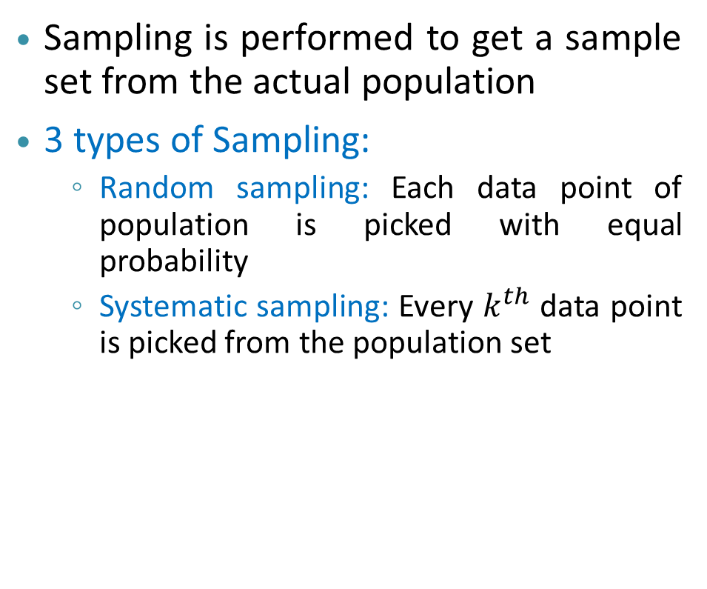
Obtaining Sample from Population
Population dataset
Sampling is performed to get a sample set from the actual population
3 types of Sampling:
Random sampling: Each data point of population is picked with equal probability
Systematic sampling: Every $k^{th}$ data point is picked from the population set
1
2
3
4
5
6
7
8
9
10
11
12
13
14
15
16
17
18
19
20
21
22
23
24
1
5
Systematically
Sampled
dataset
9
13
17
21

Slide 44
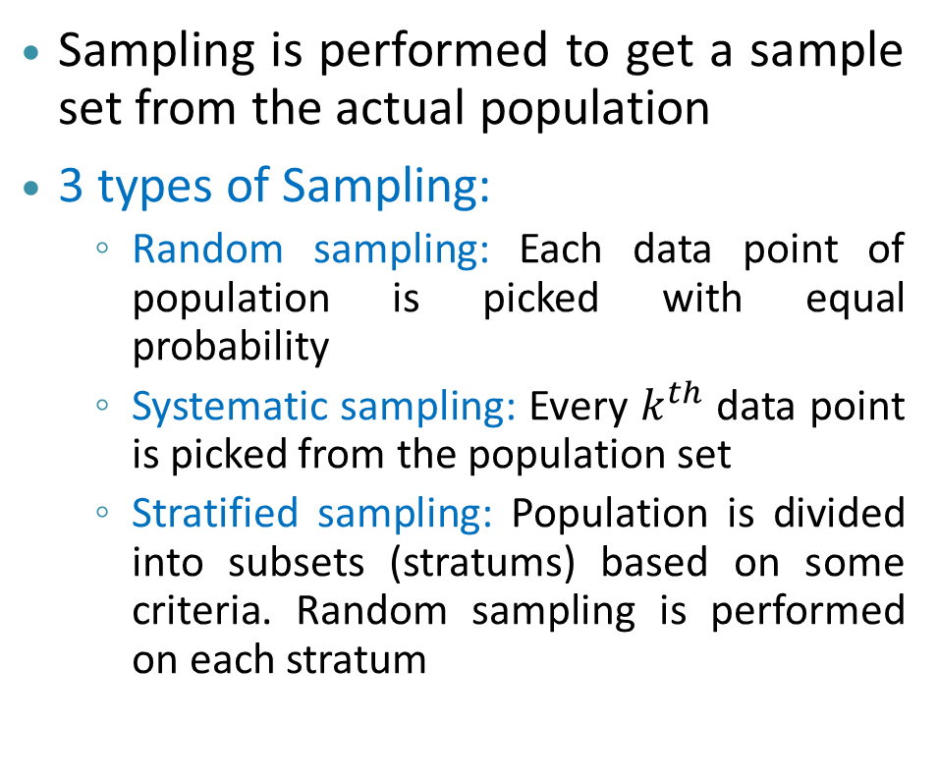
Obtaining Sample from Population
Stratified Population dataset
Sampling is performed to get a sample set from the actual population
3 types of Sampling:
Random sampling: Each data point of population is picked with equal probability
Systematic sampling: Every $k^{th}$ data point is picked from the population set
Stratified sampling: Population is divided into subsets (stratums) based on some criteria. Random sampling is performed on each stratum
1
2
3
4
5
6
7
8
9
10
11
12
13
14
15
16
17
18
19
20
21
22
23
24
1
14
Stratified
Sampled
dataset
7
18
11
23

Slide 45


Use of Sampling in Data Analytics
Situation $1$
Cost of collecting the data for the entire population would be prohibitive
It would also be logistically difficult and time consuming.
We will collect only part of the data
In cases where the entire data is automatically collected and available.
However for model development, we wish to consider only a part of the data
e.g. Bank transactions – which may be too bulky, and hence unviable.
Situation $2$
Situation 3
Most analytics algorithms requires that the data be partitioned as Training data (to develop the model), and Test data (to validate the model)

Slide 46
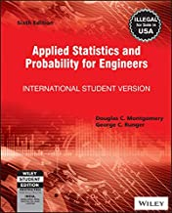
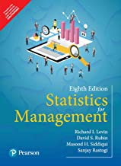

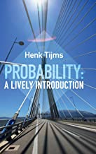
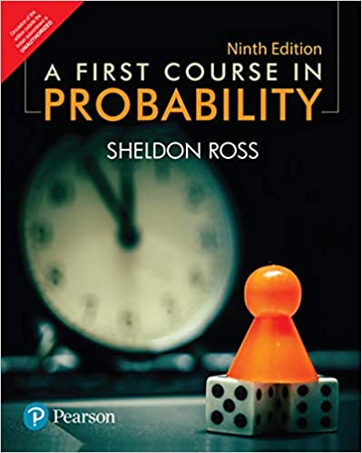
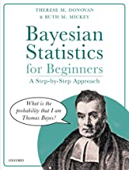
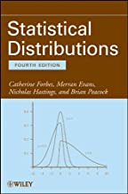
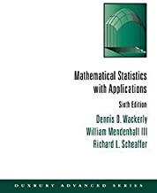
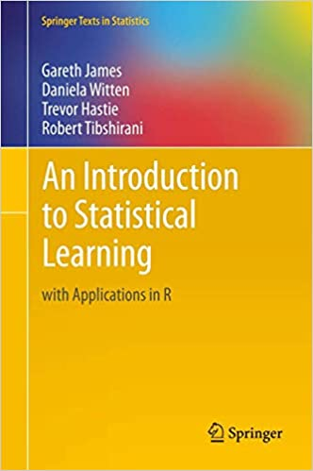
Suggestions on Books – Probability and Statistics
Introductory, easy to follow, lots of examples
Gentle Read
Expensive - Interesting
Thorough
Expensive – Gentle Introduction
Very Expensive –
Nice mathematical treatment with plenty of examples Look for Used Books stores
Application Oriented
Worth owning,
{Older edition is very affordable}
Also available as free pdf download
Expensive – Older edition should do

Slide 47
The End

